Slide 1
The use of mixture distributions in a Bayesian linear mixed effects model
Anirudh TOMER
Promoter: Professor Emmanuel LESAFFRE

Slide 2

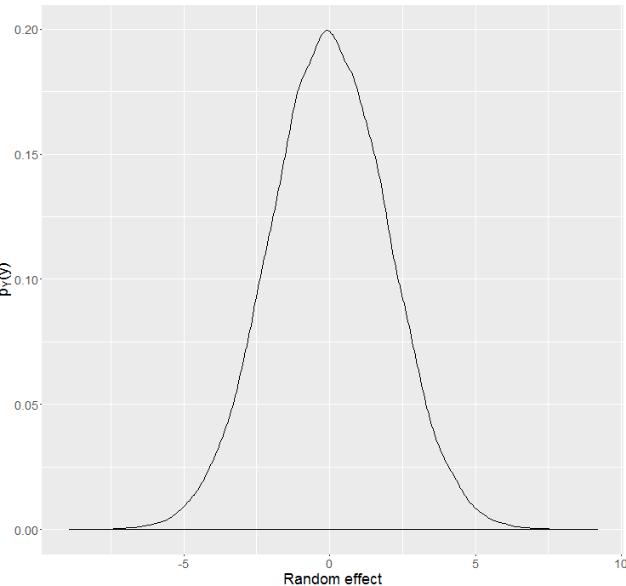
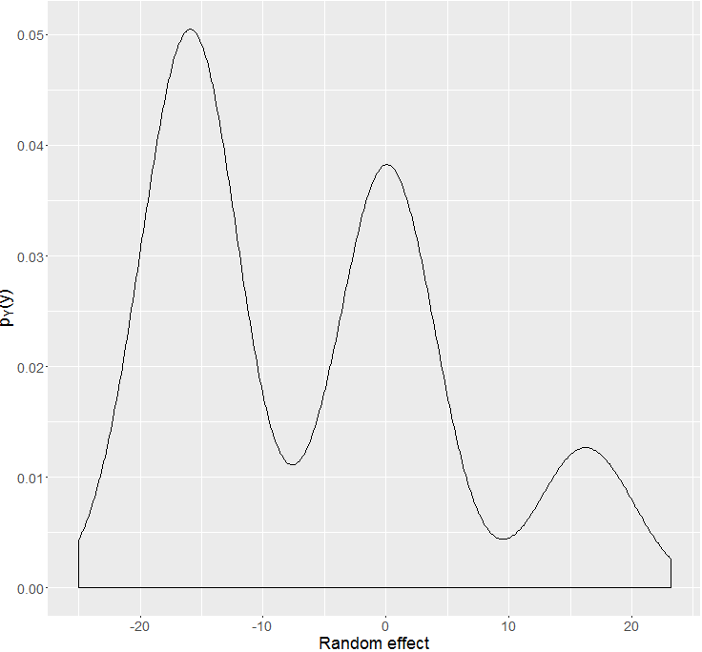






Bayesian heterogeneity model
Gender: Male, Age: 37
Gender: Female, Age: 23
Gender: Male, Age: 41
Gender: Female, Age: 59
Gender: Female, Age: 35
. .
.
. .
.
Gender: Male, Age: 19

Slide 3
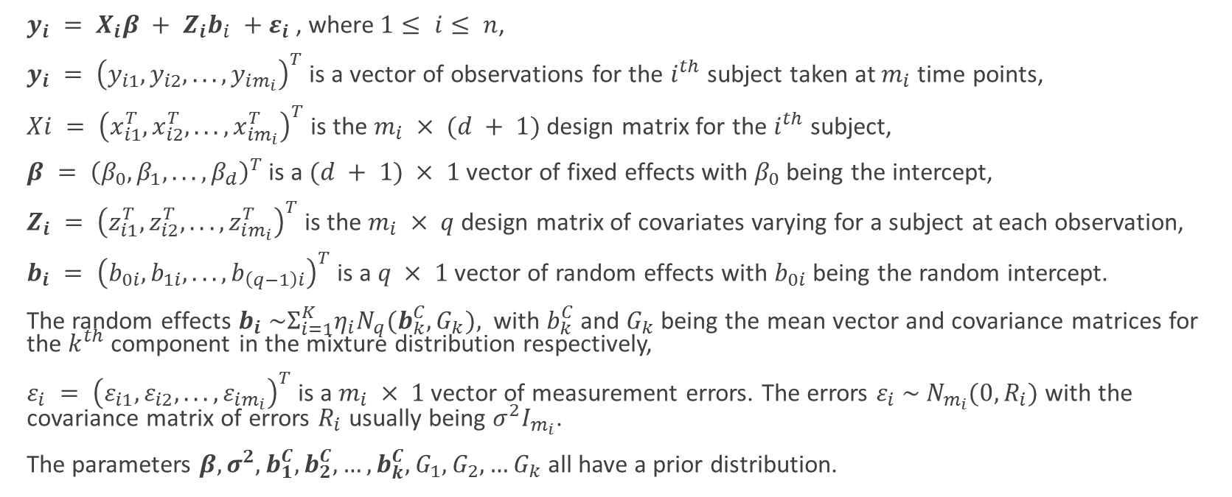
Mathematical notation
$y_{i} = X_{i}β + Z_{i}b_{i} +ε_{i}$, where$1≤ i≤ n$,
$y_{i} = {\left(y_{i1}, y_{i2}, . . . , y_{im_{i}}\right)}^{T}$is a vector of observations for the $i^{th}$ subject taken at $m_{i}$ time points,
$Xi = {\left(x_{i1}^{T}, x_{i2}^{T}, . . . , x_{im_{i}}^{T}\right)}^{T}$is the $m_{i} × (d + 1)$ design matrix for the $i^{th}$ subject,
$β = {\left(β_{0}, β_{1}, . . . , β_{d}\right)}^{T}$ is a $(d + 1) × 1$ vector of fixed effects with $β_{0}$ being the intercept,
$Z_{i} = {\left(z_{i1}^{T}, z_{i2}^{T}, . . . , z_{im_{i}}^{T}\right)}^{T}$ is the $m_{i} × q$ design matrix of covariates varying for a subject at each observation,
$b_{i} = {\left(b_{0i}, b_{1i}, . . . , b_{\left(q−1\right)i}\right)}^{T}$is a $q × 1$ vector of random effects with $b_{0i}$ being the random intercept.
The random effects $b_{i} \sim Σ_{i=1}^{K}η_{i}N_{q}(b_{k}^{C},G_{k}),$ with $b_{k}^{C}$ and $G_{k}$ being the mean vector and covariance matrices for the $k^{th}$ component in the mixture distribution respectively,
$ε_{i} = {\left(ε_{i1}, ε_{i2}, . . . , ε_{im_{i}}\right)}^{T}$ is a $m_{i} × 1$ vector of measurement errors. The errors $ε_{i} \sim N_{m_{i}}(0,R_{i})$ with the covariance matrix of errors $R_{i}$ usually being $σ^{2}I_{m_{i}}$.
The parameters $β,σ^{2}, b_{1}^{C}, b_{2}^{C},…,b_{k}^{C},G_{1},G_{2},…G_{k}$all have a prior distribution.

Slide 4
What is the problem we are facing?
Estimation of component density parameters $θ_{G}$
Estimation of component density parameters 𝜃_𝐺
Criteria for choice of number of components (DIC, Bayes Factor, PPD checks)
Classification of observations into groups

Slide 5
Why Bayesian

Slide 6
Simulation study dataset
10 repeated measurements which are equally spaced for all subjects.
Predictors were gender, birth year, time of measurement.
Various versions of the dataset with very clearly distinguishable mixture components to almost fused mixture components were considered.
No serial correlation considered.

Slide 7

DIC (deviance information criteria)
$DIC=\overline{D(θ)}+p_{D}$
Where $p_{D}=\overline{D(θ)}−D(\overline{θ})$is the effective number of parameters in the model.
$D\left(θ\right)=−2\log{p\left(y | θ\right)}+2\log{f(y)}$ is called the Bayesian deviance.
Conditional
Conditional on knowing allocations.
Conditional on knowing the random effect.
Observed
Likelihood based on observed part of the data.
Complete
Model observed and unobserved data both.
Random effect and allocations are unobserved.

Slide 8
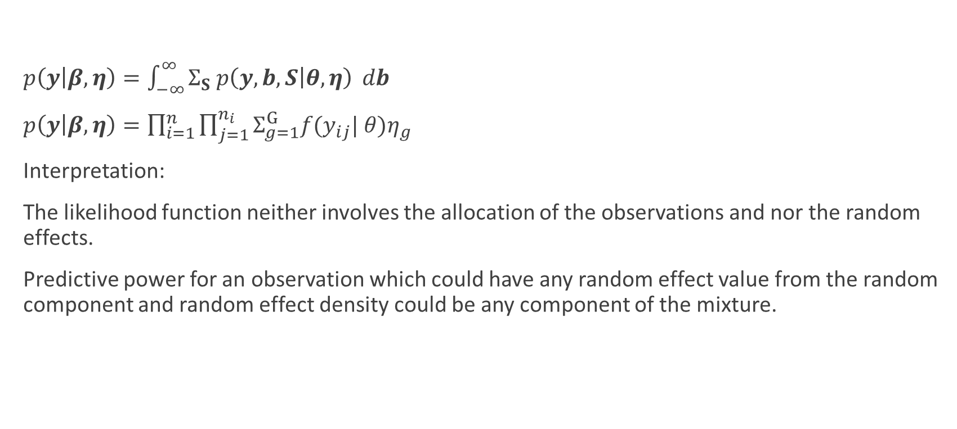
DIC based on observed data likelihood
$p\left(y | β, η\right)=\int_{−∞}^{∞}{Σ_{S} p\left(y,b,S | θ, η\right)} db$
$p\left(y | β, η\right)=\prod_{i=1}^{n}{\prod_{j=1}^{n_{i}}{Σ_{g=1}^{G}f(y_{ij}| θ)η_{g}}}$
Interpretation:
The likelihood function neither involves the allocation of the observations and nor the random effects.
Predictive power for an observation which could have any random effect value from the random component and random effect density could be any component of the mixture.

Slide 9
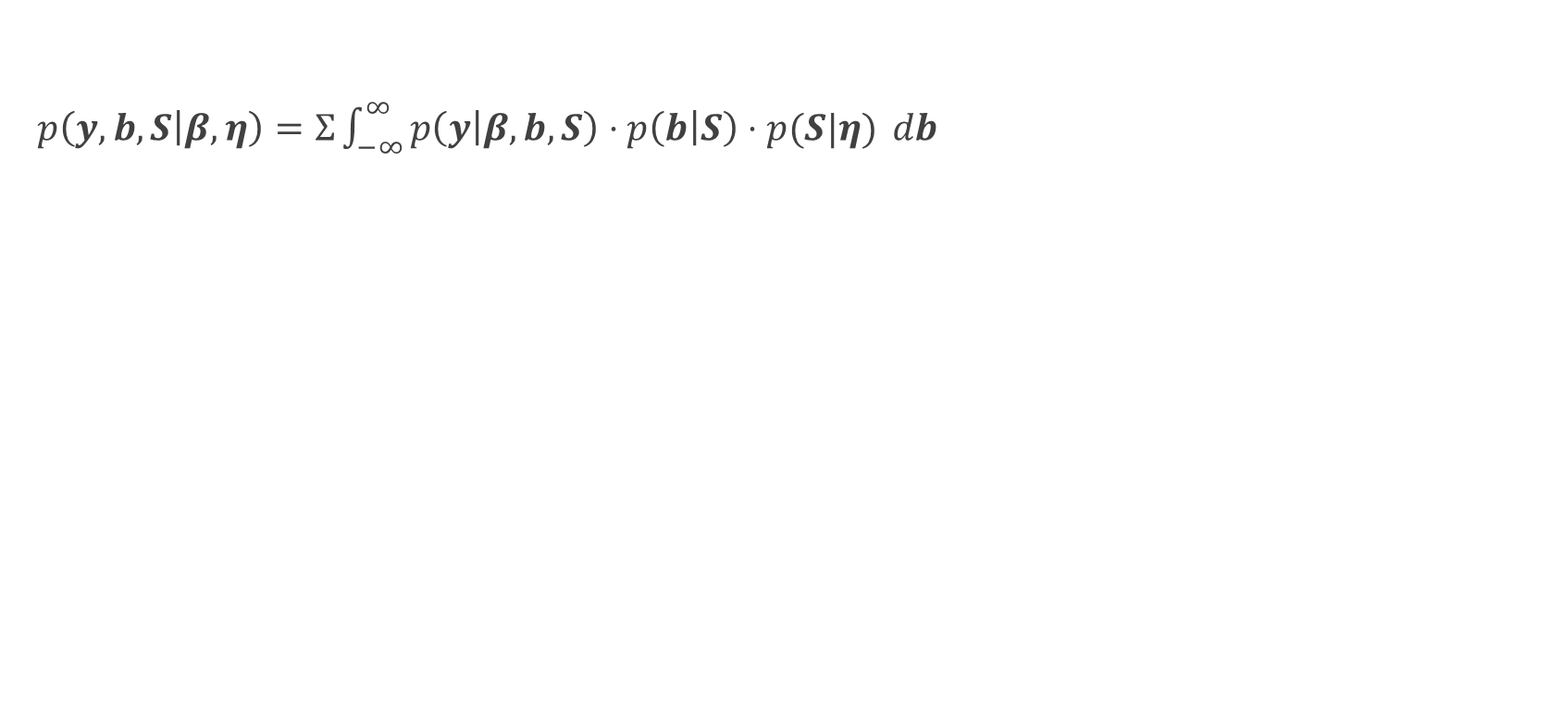
DIC based on complete data likelihood
$p\left(y,b,S | β, η\right)=Σ\int_{−∞}^{∞}{p\left(y | β, b, S\right)⋅p\left(b | S\right)⋅p(S|η)} db$

Slide 10


Issue with the alternative $pD$ formula
$p_{D}=\overline{D(θ)}−D(\overline{θ})$is approximated by $\frac{var\left(D\left(θ\right)\right)}{2}$

Slide 11
Results for 3 well separated components
Fitted Components | DIC 1 | DIC 2 | DIC 4 | DIC 5 | DIC 7
1 | 10531.02 (pD = 15.39) | 10528.17 (pD = 12.53) | 25837.71 (pD = 26.65) | 25966.21 (pD = 155.15) | 9213.49 (pD = 112.43)
2 | 10622.86 (pD = 8.59) | 10642.80 (pD = 28.52) | 26228.60 (pD = 42.98) | 26636.60 (pD = 450.99) | 9166.69 (pD = 76.05)
3 (good fit visually checked) | 13938.77 (pD = 4.41) | 13966.63 (pD = 32.27) | 22875.79 (pD = 63.78) | 23118.10 (pD = 306.08) | 9247.58 (pD = 157.10)
4 | 12364.91 (pD = 8.12) | 12387.15 (pD = 30.36) | 23767.86 (pD = 84.17) | 23965.74 (pD = 282.05) | 9250.44 (pD = 160.53)
5 | 14371.40 (pD = 149.29) | 14256.81 (pD = 34.71) | 23542.39 (pD = 87.64) | 22971.57 (pD = -483.18) | 9258.069 (pD = 166.94)
6 | 14521.31 (pD = 241.9265) | 14081.84 (pD = -197.55) | 23761.01 (pD = 99.70) | 21755.54 (pD = -1905.77) | 9255.67 (pD = 165.18)

Slide 12
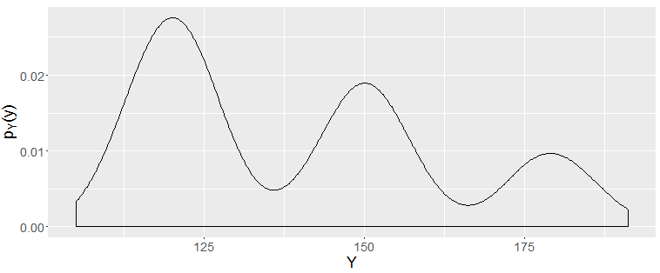
Well separated but unequal proportions

Slide 13
Results for 3 well separated components, un
Fitted Components | DIC 1 | DIC 2 | DIC 4 | DIC 5 | DIC 7
1 | 7028.43 (pD = 11.87) | 7035.24 (pD = 18.68) | 17040.36 (pD = 25.78) | 17076.01 (pD = 61.43) | 6110.43 (pD = 21.68)
2 | 7101.44 (pD = 14.22) | 7101.873 (pD = 14.66) | 17270.44 (pD = 44.16) | 17433.49 (pD = 207.21) | 6061.03 (pD = -21.71)
3 (good fit visually checked) | 7750.93 (pD = 9.28) | 7770.39 (pD = 28.73) | 15382.12 (pD = 64.10) | 15586.91 (pD = 268.89) | 6189.61 (pD = 106.94)
4 | 7783.76 (pD = 7.63) | 7854.453 (pD = 78.32) | 15658.16 (pD = 77.92) | 16037.37 (pD = 457.14) | 6189.28 (pD = 105.68)
5 | 7624.78 (pD = -162.35) | 7816.59 (pD = 29.45) | 15880.63 (pD = 85.80) | 12865.95 (pD = -2928.87) | 6191.27 (pD = 108.37)

Slide 14
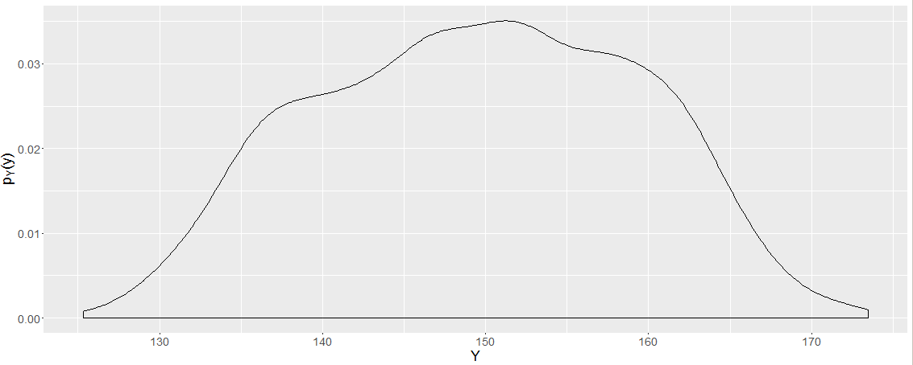
Partially fused components

Slide 15
Results for 3 partially fused components
Fitted Components | DIC 1 | DIC 2 | DIC 4 | DIC 5 | DIC 7
1 | 11652.52 (pD = 16.86) | 11631.82 (pD = -3.85) | 22250.66 (pD = 25.57) | 22449.76 (pD = 224.67) | 9252.85 (pD = 165.91)
2 (good fit visually checked) | 13050.51 (pD = -0.66) | 13045.97 (pD = -5.20) | 23105.93 (pD = 42.46) | 23751.53 (pD = 688.06) | 9235.00 (pD = 157.26)
3 | 15383.37 (pD = -99.51) | 14436.66 (pD = -1046.22) | 23209.09 (pD = 62.97) | 24137.68 (pD = 991.56) | 9238.93 (pD = 161.37)
4 | 15701.01 (pD = 77.61) | 14779.17 (pD = -844.23) | 23517.28 (pD = 75.05) | 22195.75 (pD = -1246.48) | 9230.14 (pD = 153.80)
5 | 16149.49 (pD = 295.3527) | 15155.12 (pD = -699.01) | 23812.6 (pD = 87.08) | 22494.82 (pD = -1230.70) | 9237.79 (pD = 159.73)
6 | 16806.97 (pD = 964.85) | 15324.64 (pD = -517.49) | 24151.71 (pD = 99.13) | 22906.95 (pD = -1145.64) | 9238.55 (pD = 162.99)

Slide 16
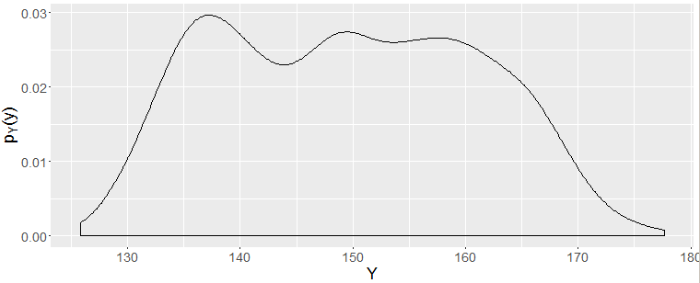
Partially fused components

Slide 17
Results for 3 partially fused components
Fitted Components | DIC 1 | DIC 2 | DIC 4 | DIC 5 | DIC 7
1 | 7478.89 (pD = 13.23) | 7476.65 (pD = 10.99) | 15304.93 (pD = 26.31) | 15428.91 (pD = 150.29) | 6183.127 (pD = 99.80)
2 | 8300.28 (pD = 6.79) | 8383.95 (pD = 90.47) | 15582.35 (pD = 43.18) | 15931.90 (pD = 392.74) | 6181.79 (pD = 104.65)
3 | 9284.91 (pD = -245.00) | 9046.34 (pD = -483.57) | 15528.08 (pD = 62.31) | 15995.44 (pD = 529.68) | 6185.74 (pD = 108.12)
4 | 10047.85 (pD = 182.57) | 9762.34 (pD = -102.94) | 15670.82 (pD = 76.11) | 13523.96 (pD = -2070.75) | 6186.42 (pD = 109.33)

Slide 18
Discussion
DIC 4 works best when components are well separated
pD in DIC1 gives an indication when components are well separated?
HW test passed

Slide 19
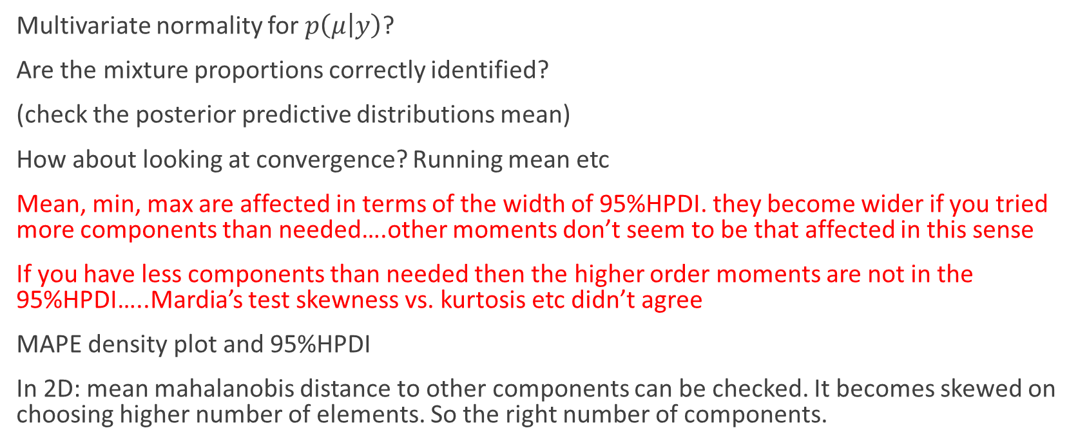

Posterior checks for $p\left(θ | y\right)$and $p(y^{f}|y)$
Multivariate normality for $p\left(μ | y\right)$?
Are the mixture proportions correctly identified?
(check the posterior predictive distributions mean)
How about looking at convergence? Running mean etc
Mean, min, max are affected in terms of the width of 95%HPDI. they become wider if you tried more components than needed….other moments don’t seem to be that affected in this sense
If you have less components than needed then the higher order moments are not in the 95%HPDI…..Mardia’s test skewness vs. kurtosis etc didn’t agree
MAPE density plot and 95%HPDI
In 2D: mean mahalanobis distance to other components can be checked. It becomes skewed on choosing higher number of elements. So the right number of components.

Slide 20
Discussion
Talk about negative pD
What are the equations and results.
Talk about priors etc….that you used
JAGS Burn in issue
JAGS constraints issue

Slide 21
What remains?
Other Bayesian measures
Modelling the data

Slide 22
Issues I am facing

Slide 23
Tools that I am using?
JAGS (just another Gibbs sampler)
R and the various packages

Slide 24

Questions?

